Slide 1
Data Science Infrastructure
Medial EarlySign

Slide 2
Agenda
The Need and The Hurdles
Birds Eye Overview
Data
Data Repository
Data Science Training Infrastructure
Analysis
Productization
Hands On Example

Slide 3
Introduction – The Need and The Hurdles
+ Birds Eye Overview

Slide 4
The Questions we ask
What is the probability of our patient to develop a specific risk? (CRC Cancer, Lung Cancer, AAA, Diabetes, CKD, …)
What is the probability that our patient will comply? (get vaccinated, take drugs, come for a visit, …)
Should we invite our patient to be tested? (For Glucose, HbA1C, Creatinine, …)
Should we release our patient back home from admission?
What would most GPs prescribe for our patient?
Which patients should be at the top of the list for an action? (vaccination, home visit, life style intervention, …)
Can I see patients from the past very similar to mine?
What will be the effect of treating my patient with a specific drug?
Was Drug A better than Drug B on average on my treated population?
Can we answer such questions using Real World Data?

Slide 5
The Need for a Platform
Many different questions/projects but very similar methodologies
Can’t write everything from scratch every time
Bugs, bugs and more bugs
Waste of precious time
Fear of doing the right thing and invest in it
No ready ML platform specializing in Medical Data.
Medical data IS different
Consistency, Productization, Versioning, Regulation
Don’t do it for a single research project
MUST do it for multiple productized projects

Slide 6

The problems with medical data
Not regular, different sizes and shapes
Some highly categorial signals
Diagnoses, Meds, …
100k and more dimensions
Temporal
How can we create strong features for the signal dynamics over time?
Sparse
Noisy
Biased , Not a randomized trial
“Leaks” in data
Not standardized

Slide 7

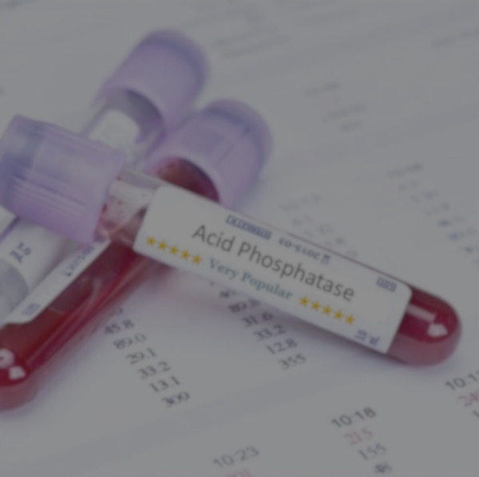
Imaging
Medical records

Slide 8
What we need the platform to do
Unified Data Model
Configurable : minimal need for rewriting code
Rich APIs to develop any needed tool
Generating rich and powerful feature matrices
Supporting state of the art ML models
Analysis Tools
Ultra efficient in memory and speed
Consistent, versioned, debugged, high quality
Minimize productization effort
Start from Data – End in model – Take to product
Transfer medical ML to a group effort – create a “language”

Slide 9
Why not use scikit-learn or tensorflow as is?
Need | Existing Platforms
Unified Medical Data Model | X
Configurable | X – can adjust some parameters for models, but can’t configure the WHOLE process and need to do it in code
Generating Rich Feature Matrices | X – Need to rewrite for each project
Analysis Tools | X – very basic, Not matching medical analysis
Efficient in Memory and Speed | X - training runs OK, the rest is highly not efficient.
Start from data – End in Model | X – Usually start from matrix
Productization | X – hard, need to write all the missing stuff
Consistency, Debugging, Augmenting | X – hard to make changes
Group effort | X – each project development is independent of others
Missing: Cleaners, Time dependency, Feature generators, imputers, models within models, analysis tools, serialize the whole process, integrated calibration, interoperability, product API, many more….

Slide 10
Birdseye Overview
Data Repository
Unification
Performance
Training Infrastructure
Deal with time dimension
Unification
Matrix Generation
Training and Analysis
Production Infrastructure
AlgoMarkers
Easy productization
On prem Sandboxes
Software wrappers
ToolSet
Efficiency

Slide 11
Data and Data Repositories

Slide 12
Typical Medical Record
Demographics
Lab Tests
Diagnosis
Drugs
Procedures
Admissions
Textual Summaries

Slide 13
Data Sources
Outpatient:
MHS – Israel, 3M (>2M members currently), almost 20 years of data
THIN – UK, 16M, 18 years of data
KPNW – US, 2M (>600k members), 10 years of data
Canadian data set – 300k , 10 years
KPSC – US, Lung Cancer data set (patients and controls)
GHS – US, design partner. Large data set.
Inpatient:
Rambam – large Israeli hospital, >200k patients, 15 years
Mimic – large ICU dataset
eICU – ICU dataset

Slide 14
Data Repository – Major Needs
Unified Data Model
Memory Efficient
Quick queries of:
Get all events of a signal for a certain patient sorted by time
Unified API to use data

Slide 15
Data Repository
FAST
UNIFORM
Data repository
Increased number of cycles = better chances to improve performance

Slide 16
Data Repository – Data Model
Each signal can have:
0 , 1, 2 or more Time Channels
0 , 1, or more Value Channels
Each Value Channel is one of:
Numerical
Categorial
Examples:
GENDER :
0 time channels
1 Value Channel, Categorial (Male/Female)
Hemoglobin :
1 time channel (date of test)
1 value channel (Numerical)
Drugs :
1 time channel (date of prescription)
2 value channels: categorial (drug full name), numerical (for how long in days)

Slide 17
Keeping data in an efficient manner
Use minimal number of bytes for each value (int, short, float, char, etc)
Never save strings for categorial signals, use dictionaries
For each patient, keep records sorted by time for each signal.
Keep data for the same patient/signal continuous in memory.
For each signal keep a very efficient index giving for each patient the position of its sorted vector (in disk, in memory).
Average memory usage per patient is a few bits (!!)
No need to copy data in 99% of the cases:
Simply return the pointer to the start of the record.
Data kept in the best manner for cpu cache usage (!)

Slide 18
Data Repository – Dictionaries & Hierarchies
Example: Drugs
Can be a 100K or more different options (different names, dosages, etc)
Signal has a dictionary mapping numbers to the actual strings
Data repository saves the numbers – saving the space
APIs allow getting the names quickly given the numbers
Dictionaries can have new values defined, and become sets.
Sets can contain other elements in the dictionary (even other sets)
Example: ATC codes (example ATC_A10 : all diabetes drugs)
APIs allow efficient querying using sets:
Is a value contained in a set
Find all cases in which there was a value contained in a set, etc

Slide 19
Data Repository – Loading process

Slide 20
Data Repository - Implementation
InfraMed:
Large C++ library to handle:
Loading of new repositories
Loading of data to an existing repository
Reading all or a subset of the data into memory (only the needed patients, only the needed signals)
Extremely fast get(pid, signal) – the most useful query.
Unified APIs to get time or value channels
APIs for dictionaries usage : querying, translating, hierarchies.
Python APIs wrapping the c++ API.
Real Life experience:
Extremely fast – enabler. Working with SQL databases can be >100x slower.
Works well on strong machines, don’t even need a large cluster:
A strong server with >64GB RAM and >8 cores is already giving good results.

Slide 21
Data Repository
A unified data model
Extremely fast in pulling data for training/testing
Full APIs to build and use such repositories:
MedRepository library : c++ based
Able to hold huge amounts of data in RAM, in a way that minimized cpu caching.
Tools on top to use it, to build such repositories, and to use them for training & testing
Python APIs as well
Ability to create repositories “on the fly” given injected data: this is what we use when applying a model in real time AlgoAnalyzer environment.
Dealing with different types of signals
Numerical (Labs)
Categorical (Diagnoses, Drugs, Admissions, Procedures)
General Signal Model:
Several Channels of time (usually 1, sometimes 2 when there’s a range of time)
Several Channels of values (value of a lab test, or 2 values (BP), or more (drug prescription), etc)
Categorical Signals:
Contain Dictionaries defining the categorical options
A dictionary can contain “Sets” of some of the categories ( a hierarchy)
Example: All Drugs and ATC codes.
Extensive tools to quickly find if a category set was used, etc.

Slide 22
Data Repository Process and Advantages
Building Process:
Normalize all data to the same names & units
Prepare dictionaries for categorical signals (ATC, ICD9, ICD10)
Load into Repository
Automatic tools for QA & testing of quality.
Main Advantage over typical SQL databases:
100x faster in reading and querying data for ML training and testing.
Optimized queries on top: for time queries, for categorical queries.
Ultra efficient c++ API on top to enable very efficient (and thin) powerful tools on top (train, test, query, use as product, viewers, etc)
A unified data model:
Test transferability of models to different data sets
Use different data sets in training
Ability to develop complex tools that can be used in a general way on a huge set of problems.
Ability to apply in field models that were developed.

Slide 23
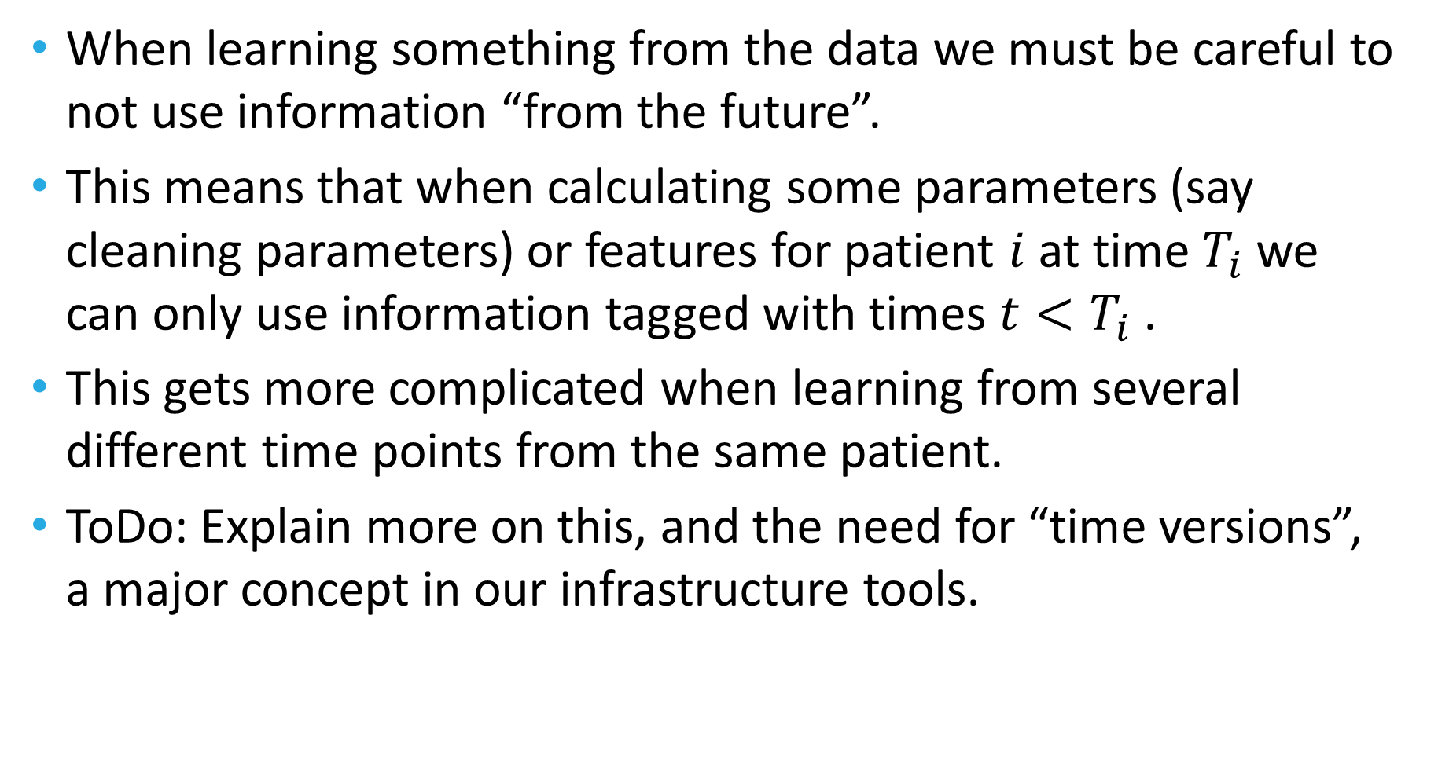
The time problem: preventing leaks
When learning something from the data we must be careful to not use information “from the future”.
This means that when calculating some parameters (say cleaning parameters) or features for patient $i$ at time $T_{i}$ we can only use information tagged with times $t<T_{i}$ .
This gets more complicated when learning from several different time points from the same patient.
ToDo: Explain more on this, and the need for “time versions”, a major concept in our infrastructure tools.

Slide 24
The path a record goes through
Rep processors
Actions that can change the record (next slide with examples)
Create online virtual signals to help generate complex features later
Feature Generators
From simple to very complex
Feature Processors
Operations over the generated features (imputing, normalizing, selection, etc)
Matrix generation
Model training/testing
Many options for modelling (Linear, svm, RF, Boosted trees, Neural Nets)
Post Processors
Calibration
But Why : explain the results
As a product: AlgoMarker API – to report back results to AlgoAnalyzer.

Slide 25
Rep Processors
All working with efficient time-versioning to enable maximal efficiency while doing the right thing.
Cleaners:
Pre configured
Rule based
Learning the distribution
Neighbor cleaning
Check requirements
Is sample eligible to participate in learning/testing/production time usage.
Virtual Signals
Registries for major diseases (Diabetes, CKD, CVD, HyperTension, Cancer, etc)
Calculated signals
Apply some functional on signal
Combine several signals into one
Select subgroups of categorical signals
Use conditions on one signal to select another
Completers/Imputers
Learn models to estimate the value for a signal at a specific time point it is missing
Note: This is learning a model inside a model classical example.
Use other learned models to create a new signal

Slide 26
Feature Generators
Functionals on a time window:
Last, Average, Mean, Max, Min, Median, Slope, Delta, …
Over a chosen time frame relative to the selected time point.
Categorical features:
Category set within a time window:
Appearing or not
Counts
Scan all or a subgroup of all sets and choose those correlated with the outcome (ability to test information gain over age+gender or any other stratification).
Use Deep Learning embedding of a large dimension into lower dimensions
Predicted values of signals at a certain time point (a model within a model)
Specific areas:
Demographic features
Smoking Features
Alcohol usage features
Drug intake features
Drug effectiveness features

Slide 27
Feature Processors
Cleaners : throw out features that are outliers
Imputers
Using stratification
By age, gender
By other signals (example by last Glucose level)
Iterative:
Iterations of predicting the missing values using the previous iteration imputations, converging to a solution.
Using GANs (deep learning)
Add features that are combinations of already created features
Open categorical features to “one hot”
Feature selection:
Univariate stratified correlation
MRMR
Lasso
Feature importance
Iterative – bottom up, top down : heavy in computation.
Manual: only named features. Using names, or the “tagging” mechanism.
Add PCA features

Slide 28
Modeling
Can control all the models parameters
Linear Models
All sorts of regularizations: Ridge, Lasso
Degree of polynomials
Random Forest variants
Boosted tree variants
In particular also LightGBM and XGBoost
Neural Nets
Export Learning to TensorFlow and pull back model inside (no need of TensorFlow package when applying model)

Slide 29
Post Processors
Calibration
On a given calibration learning set
Equal size bins
Equal cases bins
Isotonic calibration
ButWhy
Individual strength of each feature in prediction.
Aggregation over signals/groups of features.
Using Shapeley methodology variants.
Sometimes requires complex training in order to work properly.

Slide 30
Serialization
It is extremely important to be able to save all the complex paths a model needs to go through in order to get a prediction.
This means keeping all the Signals lists, Rep Processors, Feature Generators, Feature Processors, Model, and Post processors used and all their parameters.
Our serialization is able to keep all of this into one single file (!), and open it for further training, or for applying for testing or in the field.
Serialization process is complex as it allows for backward computability even when objects are changed and added.

Slide 31
Analysis
Analyzing results can be a very hard task
The bootstrap package developed internally allows for all analysis options:
Calculate all performance params: AUC, Sens, Spec, PPV, PR, all at all needed points.
Bootstrap and calculate confidence interval for results.
Survival analysis: KM curves
Estimate incidence, or use external given incidences
Do the right thing with outcomes and time windows
Sometimes the same sample is a case or control depending on the time window tested.

Slide 32
AlgoMarker API
A wrapper library allowing the usage of models in field with the AlgoAnalyzer.
Gets the serialized model file
API – to load AlgoMarker
API – to push data into a virtual in-mem repository (and clean it after usage)
API – to use model on data and get back scores (raw or calibrated), eligibility information, error information, and ButWhy information.
Heavily tested, stabilized, efficient
Uses the EXACT model created in the training (the exact serialized file).

Slide 33
Additional matters
Large set of tools to wrap all the previously described capabilities:
Build repositories
Train models
Test models
Export models
Print models
Get Matrices
Graphical viewers for patients
More…
Configurable !!!! :
To train a new model, no need to write code
A simple Json format configuration file defines ALL the stages selected for the model
Unifying the whole process of ML on medical records to one paradigm.
Performance:
extremely efficient in memory usage
Parallelization (!!!) – maximal.
Handling learning in CV effortlessly
C++ and Python tools and APIs
Effortless porting to AlgoAnalyzer
Ability to handle all sorts of ML problems:
Binary predictions
Multi Category predictions
Regression predictions
Huge amount of code invested underneath.

Slide 34
Typical Medical Record
Demographics
Lab Tests
Diagnosis
Drugs
Procedures
Textual Summaries

Slide 35
Training Infrastructure
Unified
Libraries
ToolSets
APIs
Configurable
Matrices, & Models
Cleaners
Feature Generators
Imputers
ML modeling
Analysis
Bootstrapping
External Validation
Efficiency
Parallelism

Slide 36
Training Infrastructure
Data Repository
Cleaning
Feature Generation
Imputation
Modeling
Validation
Prepare Matrix For Modeling

Slide 37
Feature Generation – simple features
Data Repository
Basic Cleaning
Feature Generation
Imputation
Modeling
Validation
Lab Tests are not in uniform sizes
Different number of tests per patient
Different times
Learn/Predict Matrix has to be of a fixed size
… | Slope | Avg | Max | Last
… | Slope | Avg | Max | Last

Slide 38
Feature Generation – modeled features
Data Repository
Basic Cleaning
Feature Generation
Imputation
Modeling
Validation
Train Models to Predict:
Future Values of test
Past Values of test
Using only this lab test, or also combining others
?
?

Slide 39
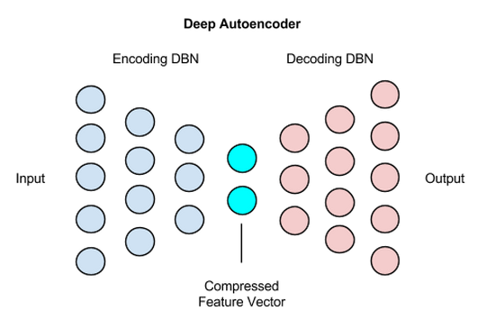
Feature Generation – Autoencoder Features
Data Repository
Basic Cleaning
Feature Generation
Imputation
Modeling
Validation
Step1:
Generate a feature matrix using previous methods.
Step2:
Train an autoencoder on matrix
Additional Flavor:
Train the autoencoder on features 1 year ahead
Add Layer to Features
OR
Use Layer as Features

Slide 40
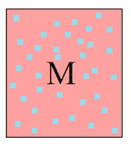
Feature Matrix Imputation
Data Repository
Basic Cleaning
Feature Generation
Imputation
Modeling
Validation
At this stage we got a matrix of the current features:
Rows : a row for each patient id + time point participating
Columns: the different features created so far
There are typically many missing values
In many cases (Neural Nets for example) a complete matrix is needed for the Modeling stage
M0
Initial Imputing
Based on age and gender statistics
M0
Train model on non
Imputed points to predict value
M1
Use model to predict imputed points
Repeat training for
several cycles
Regression Models
Trees
NN

Slide 41
Actual Classifier - Finally
Data Repository
Basic Cleaning
Feature Generation
Imputation
Modeling
Validation
1.2
Many Options
Typically Best Results are with:
Random Forest Variants
Gradient Boosting (typically with regression trees)
Neural Nets (typically fully connected 2-4 layers)
1
0.8
0.6
0.4
0.2
0
-0.2
-1.5
-1
-0.5
0
0.5
1
So Far – results from these different methods are more or less at the same performance in medical records problems
Open Deep Learning Problem: Find an information extractor “like CNNs” for Medical Records problems

Slide 42
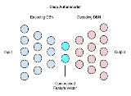
The Journey
Data Repository
Basic Cleaning
Feature Generation
Imputation
Modeling
Validation
RF
Bootstrap
Analysis
GBM
Bootstrap
Analysis
NN
Bootstrap
Analysis
Stack
Bootstrap
Analysis

Slide 43
Moving To Infrastructure & Productization
A unified language to define and work with problems.
Raw Data
Semi Automated
Repository
Optional
Modeling
& Testing
Export as AlgoMarker
Cohort
Train/Test Lists
Configure:
Cleaning
Features
Selection
Normalization
Model
Sampling
Filtering
Matching
Splitting

Slide 44
Internal or External Sandboxes
Internal
External
Data Center
20M+ records
100M+ patient years
Data Server
Client Data
Computing Cluster
Computing Server
Installed with Medial Tools
Repository/Training/Testing/Exporting
Secured
Secured Access

Slide 45
Transfer Learning
Internal
External
+
Model
Scores
Client Data
Features
Model
Retrained
Model
Trained on internal Data
Biological
No “client specific” features
Trained on large datasets
Uses the power of the Internal model
Incorporates client specific data to improve performance

